Slide 1
Shell Programming
Ron Sun
ron.sun@citigroup.com

Slide 2
Shell Programming
The shell is also a programming language that executes shell scripts in the interpretive mode – one line at a time.
Shell scripts run slower than compiled languages like C, but for many jobs speed is no hurdle.
Perl is more used as a language for the system administration. An UNIX system administrator is supposed to be an accomplished shell programmer.

Slide 3
Shell Variables
A shell variable is assigned with the = symbol without using the $, but is evaluated by prefixing it with a $:
fname=profile; echo $fname
The unset statement removes a variable from the shell.
Variables are concatenated by placing them side by side; no operators are needed:
x=foo; y=.doc; z=$x$y; echo $z

Slide 4
Shell Variables
Shell variables can be evaluated by using curly braces around the variable name.
echo ${fname}
These braces also enable concatenation of a variable and a string.
echo ${fname}x or echo $fname”x”
These concatenation features are useful when changing a file’s extension.

Slide 5
Shell Variables
Using curly braces, the multiple command sequence can be written in this way:
boldon=`tput smso` ; boldoff=`tput rmso`
echo ${boldon}Come to the Web$boldoff
A shell script is an ordinary file containing a set of commands, which is executed in an interpretive manner in a sub-shell. It is also known as a shell program or shell procedure.

Slide 6
Shell Scripts
You can execute a shell script in two ways:
  Make it executable with chmod before running it (chmod +x).
  It can also be run with the sh command.
Use # to comment lines in the shell script.
Shell scripts are always run in a separate shell – a sub-shell.
Consider the example on Page 537:

Slide 7
Shell Scripts
# Sample shell script # Use # to comment lines
echo "The date today is `date`"
echo Your shell is $SHELL
echo Your home directory is $HOME
echo The processes running are shown below:
ps
You can specify the shell a script must use by placing the statement #/bin/sh in the first line of the script.
ksh and bash are for korn and bash shells.

Slide 8
read: Making Scripts Interactive
The read statement accepts input to a script from the keyboard.
When you use a statement like read name the script pauses at that point to take input from the keyboard.
A script containing a read statement can be redirected to take input from a file.
Consider a file list:

Slide 9
read: Making Scripts Interactive
$ cat list
director
emp2.lst
$ emp1.sh < list
You can run a script noniteractively by specifying arguments in the command line.
These arguments are accepted into the positional parameters $1, $2, and so on.

Slide 10
The Logical Operators && and || - Conditional Execution
The && and || operators act as simple one-way conditionals.
When && delimits two commands, the second command is executed only when the first command succeeds.
$ grep ‘director’ emp1.lst && echo “pattern found in file”
In the case of ||, the second command is executed only when the first command fails.
$ grep ‘manager’ emp2.lst || echo “pattern found in file”

Slide 11
exit: Script Termination
The exit statement terminates a script. It can be used with a number signifying the success or failure.
#!/bin/sh
echo "Program: $0" # $0 contains the program name
echo "The number of arguments specified is $#“
echo "The arguments are $*"
# exit also takes an argument
grep "$1" $2 >patlist 2>/dev/null || exit 2
echo "Pattern found -- Contents shown below"
cat patlist
$ emp2a.sh manager emp3.lst

Slide 12
Conditional Commands
if command
  if command
  then
  command_list
  fi
  if command
  then
  command_list
  else
  another_command_list
  fi

Slide 13
Conditional Commands(Cont.)
if command
  if command
  then
  command_list
  elif another_command
  another_command_list
  fi
case command
case value in
pattern_1) command_list ;;
pattern_2) command_list ;;
esac

Slide 14
Conditional Commands - Example
#!/bin/bash
#
# FILE: conditional.sh
# PURPOSE: Example script showing if and case commands
# Asks for a username and then reports whether that
# is a valid username for the current system.
# AUTHOR: David Jones
# HISTORY: 30 Dec, 1998 Created
# read in the username
echo -n enter username to search for '==&gt; '
read username
# check whether it exists

Slide 15
Conditional Commands – Example (Continue)
if grep -q "^$username:" /etc/passwd
then
echo The username $username is valid for this system.
case $username in
root) echo It is the system root user account
exit 0 ;;
mail) echo It is the mail system account
exit 0 ;;
bin|daemon|adm|lp|sync|shutdown|halt|news|uucp|operator|games)
echo It is one of the other system accounts
exit 0 ;;
*) echo Chances are it is a normal user account
esac
else
echo The username $username is NOT valid for this system.
fi

Slide 16
Testing
Two version of the test command
  test expression
  [ expression ]
Both evaluate a boolean expression and set the return/exit status
  0 if expression was true
  1 if expression was false

Slide 17
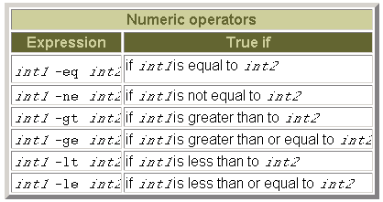
Test's operators

Slide 18
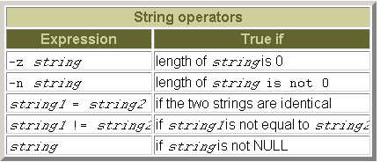
Test's operators

Slide 19
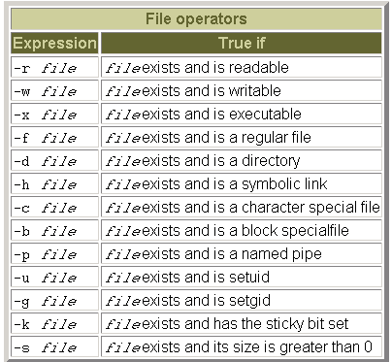
Test's operators

Slide 20
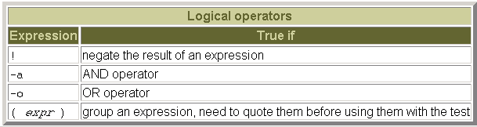
Test's operators

Slide 21
Looping Commands
Bourne shell provides three looping structures
  while loop
  while command
  do command_list
  done
  until loop
  until command
  do command_list
  done
  for loop
  for variable in list_of_values
  do command_list
  done

Slide 22
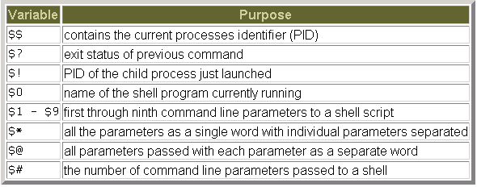
Pre-defined variables

Slide 23
Useful Commands
Ls
Ps
Grep
Top
Pwd
Cd
Cp
Mv
Rm
Ln
kill
prstat
Mkdir
Echo
Cat
Vi
Sed
Uniq
Cut
man

Slide 24
Q & A

Slide 25
Thank You!

